Slide 1
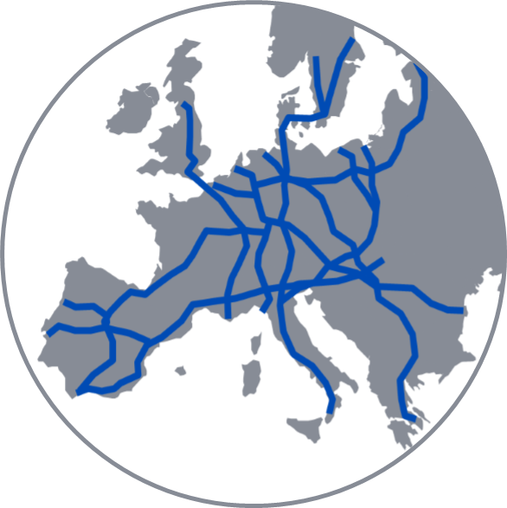











  C-OSS
  Community
International Timetabling Calendar 2024
2024
Date in 2024 | Event
8th January | Publication of PaP Catalogue
8th April | Last day to request PaPs
22nd April | PaP Pre-Booking Information
9th April – 1st July | Construction of the Timetable
1st July | Publication of International Draft Timetable
2nd July – 2nd August | Observations and Comments from Customers
19th August | Publication of International Final Timetable
24th August | Acceptance of Final Offer
14th October | Publication of Reserve Capacity
15th December | Start of Timetable 2025
January |  |  |  |  |  |  |  | February |  |  |  |  |  |  |  | March |  |  |  |  |  |  |  | April
Su | Mo | Tu | We | Th | Fr | Sa |  | Su | Mo | Tu | We | Th | Fr | Sa |  | Su | Mo | Tu | We | Th | Fr | Sa |  | Su | Mo | Tu | We | Th | Fr | Sa
 | 1 | 2 | 3 | 4 | 5 | 6 |  |  |  |  |  | 1 | 2 | 3 |  |  |  |  |  |  | 1 | 2 |  |  | 1 | 2 | 3 | 4 | 5 | 6
7 | 8 | 9 | 10 | 11 | 12 | 13 |  | 4 | 5 | 6 | 7 | 8 | 9 | 10 |  | 3 | 4 | 5 | 6 | 7 | 8 | 9 |  | 7 | 8 | 9 | 10 | 11 | 12 | 13
14 | 15 | 16 | 17 | 18 | 19 | 20 |  | 11 | 12 | 13 | 14 | 15 | 16 | 17 |  | 10 | 11 | 12 | 13 | 14 | 15 | 16 |  | 14 | 15 | 16 | 17 | 18 | 19 | 20
21 | 22 | 23 | 24 | 25 | 26 | 27 |  | 18 | 19 | 20 | 21 | 22 | 23 | 24 |  | 17 | 18 | 19 | 20 | 21 | 22 | 23 |  | 21 | 22 | 23 | 24 | 25 | 26 | 27
28 | 29 | 30 | 31 |  |  |  |  | 25 | 26 | 27 | 28 | 29 |  |  |  | 24 | 25 | 26 | 27 | 28 | 29 | 30 |  | 28 | 29 | 30
 |  |  |  |  |  |  |  |  |  |  |  |  |  |  |  | 31
May |  |  |  |  |  |  |  | June |  |  |  |  |  |  |  | July |  |  |  |  |  |  |  | August
Su | Mo | Tu | We | Th | Fr | Sa |  | Su | Mo | Tu | We | Th | Fr | Sa |  | Su | Mo | Tu | We | Th | Fr | Sa |  | Su | Mo | Tu | We | Th | Fr | Sa
 |  |  | 1 | 2 | 3 | 4 |  |  |  |  |  |  |  | 1 |  |  | 1 | 2 | 3 | 4 | 5 | 6 |  |  |  |  |  | 1 | 2 | 3
5 | 6 | 7 | 8 | 9 | 10 | 11 |  | 2 | 3 | 4 | 5 | 6 | 7 | 8 |  | 7 | 8 | 9 | 10 | 11 | 12 | 13 |  | 4 | 5 | 6 | 7 | 8 | 9 | 10
12 | 13 | 14 | 15 | 16 | 17 | 18 |  | 9 | 10 | 11 | 12 | 13 | 14 | 15 |  | 14 | 15 | 16 | 17 | 18 | 19 | 20 |  | 11 | 12 | 13 | 14 | 15 | 16 | 17
19 | 20 | 21 | 22 | 23 | 24 | 25 |  | 16 | 17 | 18 | 19 | 20 | 21 | 22 |  | 21 | 22 | 23 | 24 | 25 | 26 | 27 |  | 18 | 19 | 20 | 21 | 22 | 23 | 24
26 | 27 | 28 | 29 | 30 | 31 |  |  | 23 | 24 | 25 | 26 | 27 | 28 | 29 |  | 28 | 29 | 30 | 31 |  |  |  |  | 25 | 26 | 27 | 28 | 29 | 30 | 31
 |  |  |  |  |  |  |  | 30
September |  |  |  |  |  |  |  | October |  |  |  |  |  |  |  | November |  |  |  |  |  |  |  | December
Su | Mo | Tu | We | Th | Fr | Sa |  | Su | Mo | Tu | We | Th | Fr | Sa |  | Su | Mo | Tu | We | Th | Fr | Sa |  | Su | Mo | Tu | We | Th | Fr | Sa
1 | 2 | 3 | 4 | 5 | 6 | 7 |  |  |  | 1 | 2 | 3 | 4 | 5 |  |  |  |  |  |  | 1 | 2 |  | 1 | 2 | 3 | 4 | 5 | 6 | 7
8 | 9 | 10 | 11 | 12 | 13 | 14 |  | 6 | 7 | 8 | 9 | 10 | 11 | 12 |  | 3 | 4 | 5 | 6 | 7 | 8 | 9 |  | 8 | 9 | 10 | 11 | 12 | 13 | 14
15 | 16 | 17 | 18 | 19 | 20 | 21 |  | 13 | 14 | 15 | 16 | 17 | 18 | 19 |  | 10 | 11 | 12 | 13 | 14 | 15 | 16 |  | 15 | 16 | 17 | 18 | 19 | 20 | 21
22 | 23 | 24 | 25 | 26 | 27 | 28 |  | 20 | 21 | 22 | 23 | 24 | 25 | 26 |  | 17 | 18 | 19 | 20 | 21 | 22 | 23 |  | 22 | 23 | 24 | 25 | 26 | 27 | 28
29 | 30 |  |  |  |  |  |  | 27 | 28 | 29 | 30 | 31 |  |  |  | 24 | 25 | 26 | 27 | 28 | 29 | 30 |  | 29 | 30 | 31

Slide 2












  C-OSS
  Community
Corridor One-Stop-Shop Contacts
C-OSS Concept
RFC Rhine-Alpine
RFC North Sea-Med
RFC Scan-Med
RFC-Corridors offer high quality train paths enhancing international rail freight
C-OSS acts as proficient facilitator for issues concerning international train paths
Customer-oriented collaboration of all C-OSS simplifies requests of multi-corridor paths
Offering convenient products for international rail freight represents the collective vision of the C-OSS Community
Mrs. Stephanie Bscheid
Phone: +49 69 265 31120
coss@corridor-rhine-alpine.eu
Mr. Jean Quaeyhaegens
Phone: +32 490 471 522
jean.quaeyhaegens@infrabel.be
Mr. Rainer Wolf
Phone: +49 69 265 26773
rainer.wolf@scanmedfreight.eu
RFC Atlantic
RFC Baltic-Adriatic
RFC Mediterranean
Mr. Félix Bartolomé Alonso
Phone: +34 917 744 774
oss@atlantic-corridor.eu
Mrs. Sandra Ferrari
Phone: +39 335 7645417
c-oss@rfc5.eu
Mr. Stephane Dastot
Phone: +39 324 829 8130
oss@medrfc.eu
RFC Orient/
East-Med
RFC North Sea-Baltic
RFC Rhine-Danube
Mr. József Ádám Balogh
Phone: +36 30 696 8555
coss@rfc7.com
Mrs. Anna Difliff
Phone: +49 1523 7525 962
anna.difliff@deutschebahn.com
Mr. Bernd Wetzel
Phone: +49 1523 2104 340
Bernd.B.Wetzel@deutschebahn.com
RFC Alpine –
Western Balkan
RFC Amber
Mr. Dino Džafo
Phone: +386 41 787 056
dino.dzafo@hzinfra.hr
Mr. Roman Stanczak
Phone: +48 22 473 34 69
Roman.stanczak@plk-sa.pl

